Slide 1
Discovering spatially variable genes in spatial transcriptomics datasets
University of Belgrade, School of Electrical Engineering
Course: Computational Genomics
Students: Aleksandra Stanojevć 2020/3352, Đordje Malešević 2020/3354

Slide 2
Agenda
What are Spatially Variable Genes (SVGs)?
SpaGFT
Approach: Moran’s global I and Geary’s global C
Implementation
Evaluation and Results

Slide 3
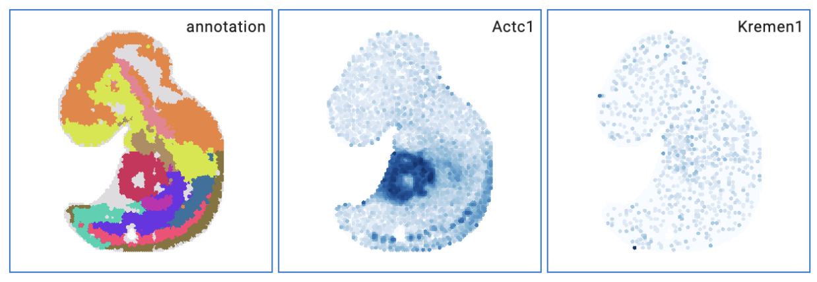
What are Spatially Variable Genes (SVGs)?
From the project definition: Spatially variable genes (SVG) in spatial transcriptomics datasets are defined as genes with a highly spatially correlated pattern of expression, which varies along with the spatial distribution of a tissue structure of interest
In simple terms, those are the genes with non-uniform expression across the tissue.

Slide 4
SpaGFT
SpaGFT is a python package to analyze tissue functions empowered using spatial omcis data.
SpaGFT can transform complex spatial patterns into one-dimensional, simple but informative Fourier Coefficients (FCs). In this way, several tasks can be achieved by analyzing FCs, include identifying spatially variable genes (SVG), detecting tissue modules (TM), and enhancing gene expression.

Slide 5
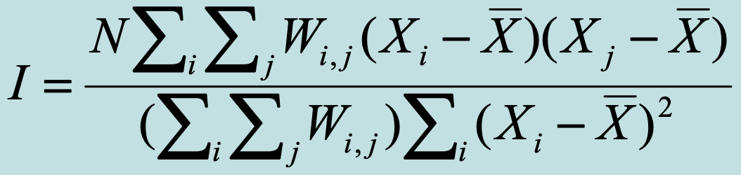
Approach: Moran’s global I and Geary’s global C
Spatial Autocorrelation: correlation of a variable with itself through space
First law of geography: “everything is related to everything else, but near things are more related than distant things” – Waldo Tobler
Moran’s I: One of the oldest indicators of spatial autocorrelation. Still a defacto standard for determining spatial autocorrelation. Compares the value of the variable at any one location with the value at all other locations. Usually between -1 and 1
N is the number of cases
Xi is the variable value at a particular location
Xj is the variable value at another location
X̄ is the mean of the variable
Wij is a weight applied to the comparison between location i and location j

Slide 6
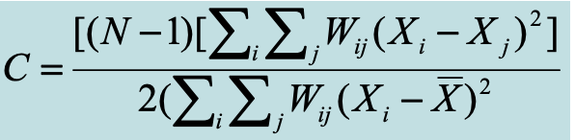
Approach: Moran’s global I and Geary’s global C
Geary’s C: Similar to Moran’s I. Interaction is not the cross-product of the deviations from the mean, but the deviations in intensities of each observation location with one another
Value typically range between 0 and 2, and if value of any one zone are spatially unrelated to any other zone, the expected value of C will be 1
N is the number of cases
Xi is the variable value at a particular location
Xj is the variable value at another location
X̄ is the mean of the variable
Wij is a weight applied to the comparison between location i and location j

Slide 7
Approach: Moran’s global I and Geary’s global C
In calculating Moran's I and Geary’s C, the weight matrix W plays a crucial role as it defines the spatial relationships between cells in the dataset. This is why we decided to take some time and try out different representations of W.
Scanpy library gives a lot of flexibility when it comes to designing this matrix using their neighbours function. There are two methods:
KNN graph: the resulting matrix contains spatial distances between a chosen cell and its K neighbours
Gaussian Kernel: is used to assign low weights to neighbors that are more distant than the n_neighbors nearest neighbor
Turns out Gaussian Kernel gives better results because it is not as restrictive as KNN

Slide 8
Approach: Moran’s global I and Geary’s global C
Another important thing: the size of the neighbourhood.
When testing the number of neighbours required for the algorithm, bigger neighbourhood gave better results in general since it provides a more global view of the spatial structure.
By using a bigger neighbourhood, Moran’s I and Geary’s C are more able to capture relationships between distant cells. Results will be shown later.
Of course, bigger neighbourhood is also more computationally expensive.
In our case, 1000 NNs gave the best results, so this number is used in the spatial neighbours calculation.
There are also various distance metrics available, and we decided to use Euclidean distance, which is the default one.

Slide 9
Implementation
The idea of the algorithm was to test both of the indicators (Moran’s I and Geary’s C), as well as different weight matrices, and to combine the results (using weights) in order to get the best results possible .
For each gene a score is calculated (Moran’s I and Geary’s C), and using this score, a gene is assigned a specific rank which represents its spatial variability in the dataset.
We can use these ranks separately, or combine them to get new ranks which represent the output of the combination of these two metrics.

Slide 10
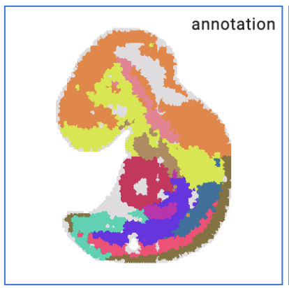
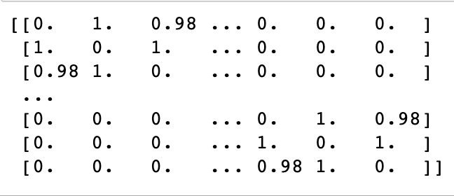
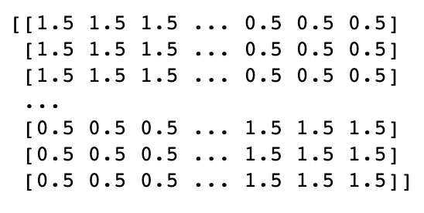
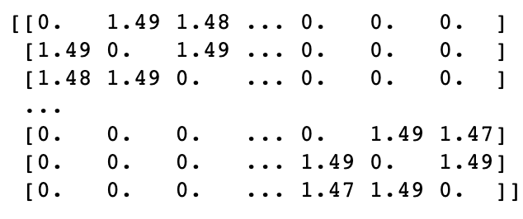
Implementation
Weight Matrix calculation: the idea is to gave higher weights to those cells that belong to the same tissue (share the same annotation). This way, neighbours from the same tissue are prioritized and both statistics are more able to utilize this information. This can be easily done using element-wise matrix multiplication. Scaling weights are parameters of the function.
Connectivity Matrix
Scaling Matrix
Weight Matrix
*
=

Slide 11
Evaluation and Results
For the algorithm evaluation, we have used some standard approaches for classification tasks:
Confusion Matrix
F1 score
AUC
Spearman’s Rank Correlation: convenient because it compares ranks for all genes
SpaGFT calculates a score which determines spatial variability of each specific gene in the dataset. It also provides a p value for each score which can be used to determine the statistical significance of the score calculated. We have chosen a common threshold of 0.05 to determine the statistically significant SVGs. This way, for the first dataset (Mouse embryo 9.5), the algorithm has returned 2246 SVGs.
In our case, based on the ‘ground truth’ and the distribution of scores, we have decided to use a threshold of 10% most spatially variable genes and call them SVGs. This way, we have obtained 2006 SVGs

Slide 12
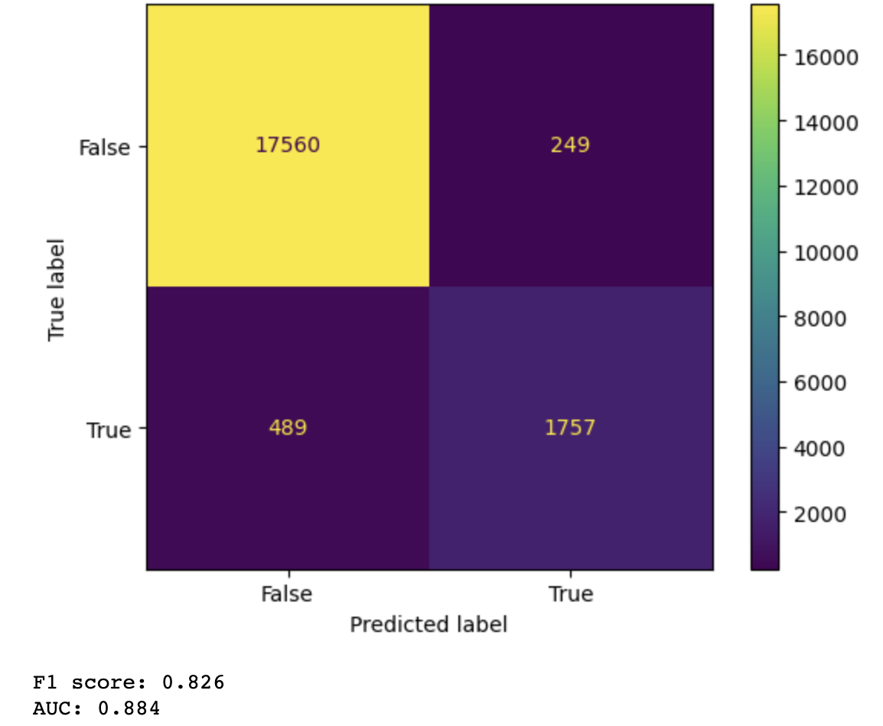
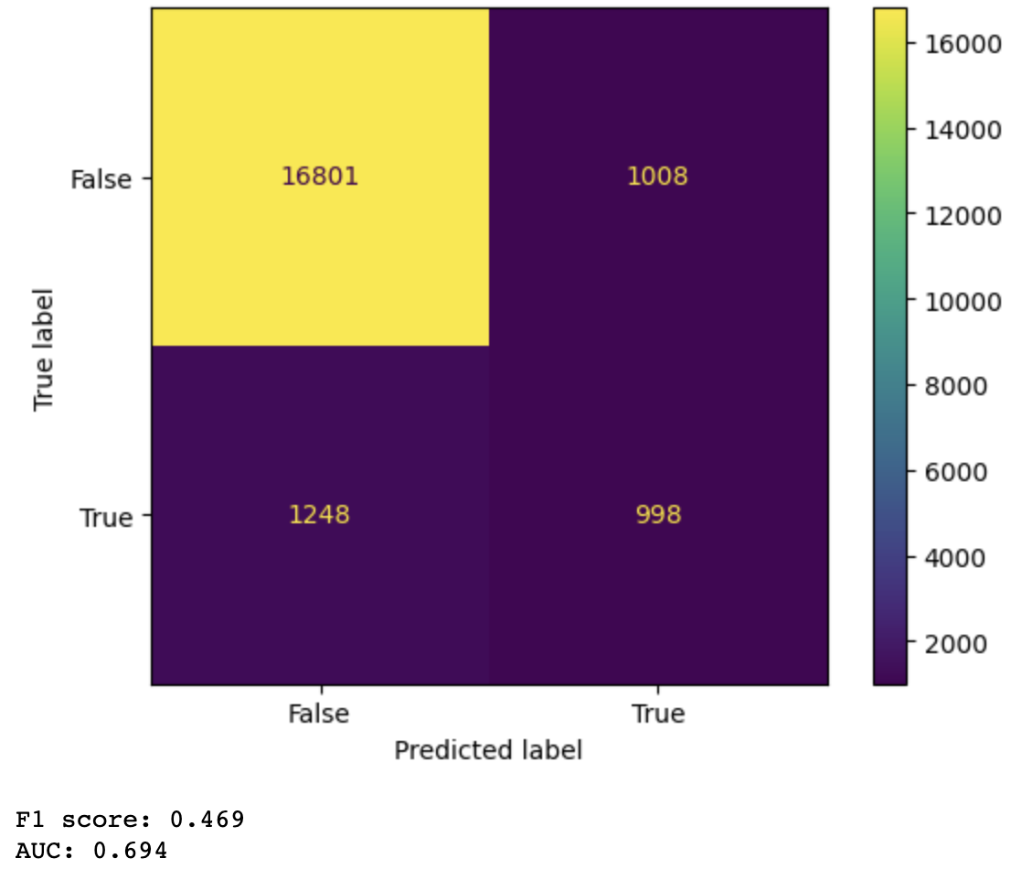
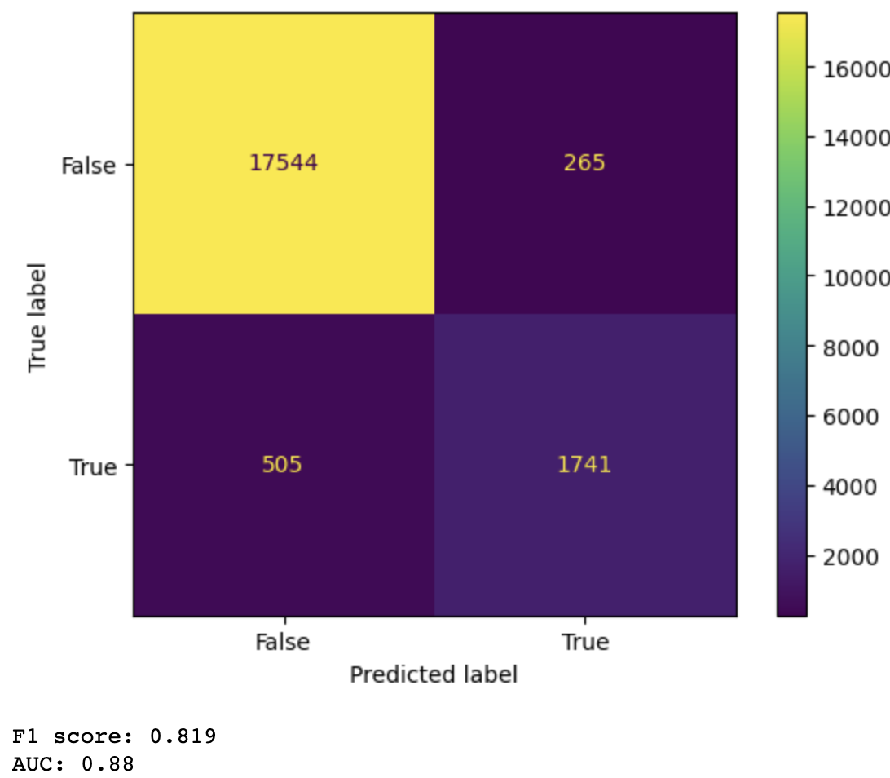
Evaluation and Results
Moran’s I gave a lot better results than Geary’s C, and combining them didn’t contribute a lot
Spearman's rank correlation coefficient: 0.901
Spearman's rank correlation coefficient: 0.327
Spearman's rank correlation coefficient: 0.906

Slide 13
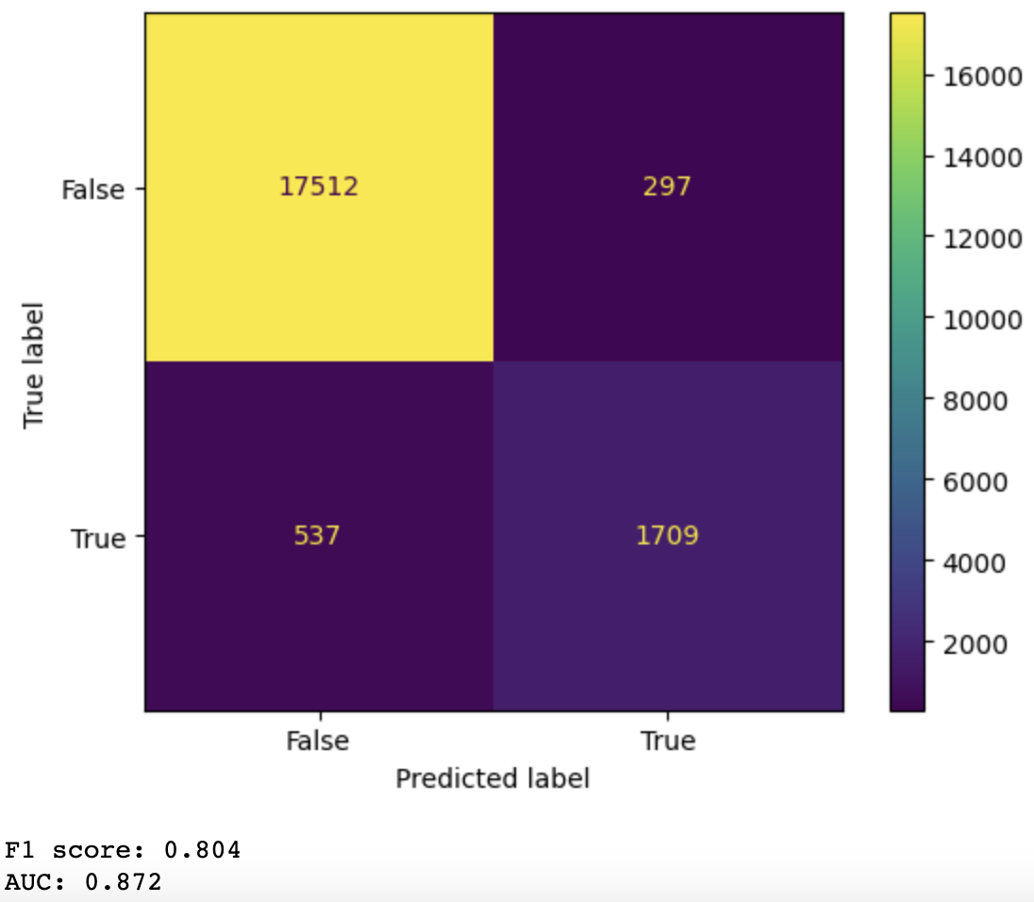
Evaluation and Results
Introducing Weight Matrix penalty for the connectivity matrix also didn’t influence the result a lot
Scaling factors (weights):
1.5 for the same tissue anno
0.5 for the different tissue anno
Spearman's rank correlation coefficient: 0.901
Spearman's rank correlation coefficient: 0.858

Slide 14
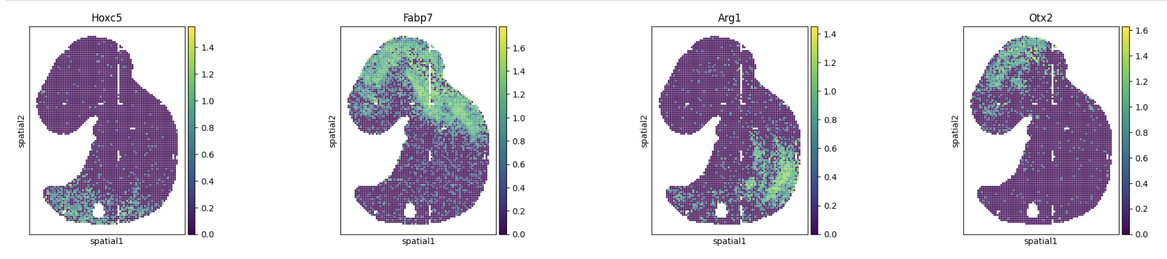
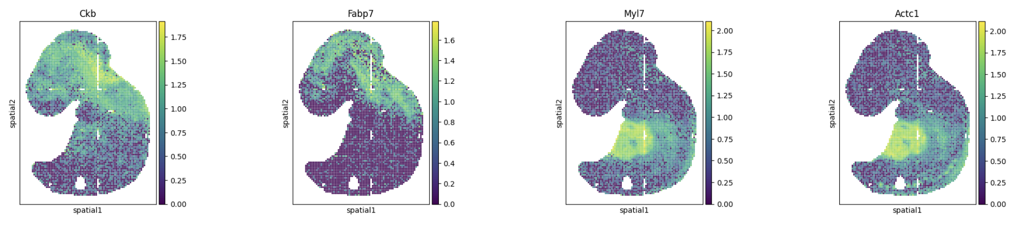
Evaluation and Results: top 4 genes obtained
SpaGFT
Moran
+
Geary

Slide 15
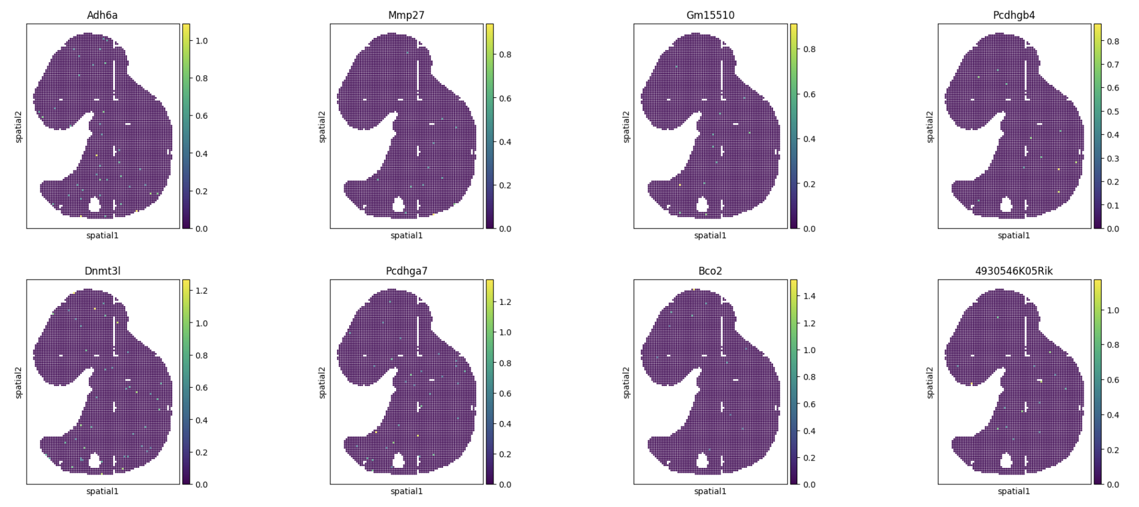
Evaluation and Results: 8 most different genes

